Slide 1
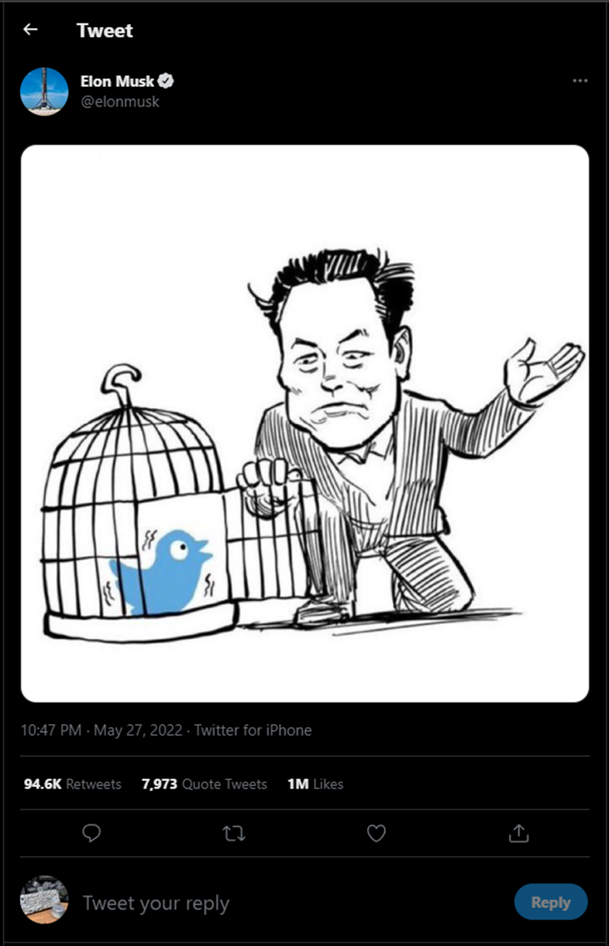
Tweets of
@Elon Musk
2020 thru 2021
And
DOGE “Coin”
2020 thru 2021

Slide 2
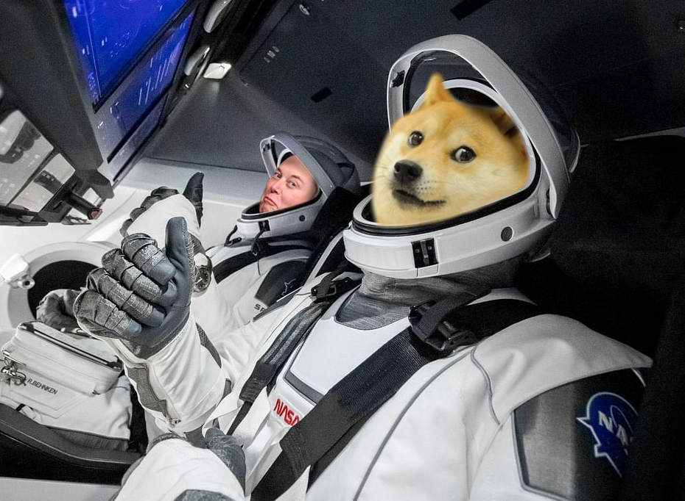
Tweets of
@Elon Musk
2020 thru 2021
And
DOGE “Coin”
2020 thru 2021

Slide 3
Introduction
Overall, this study sought to associate Elon Musk’s twitter activities with fluctuations in attributes of the Crypto Market
For this presentation we will look at the popularity of Musk's tweets for the period, and what the most frequent tokens were.
The findings have led to questions that require additional analysis.

Slide 4
Background
Cryptocurrencies are in USD Value here
DOGE : Regularly influenced by Musk’s mention related to business
Question: Can we find evidence of this influence through
Popularity of Musk’s Tweets
His mention of DOGE

Slide 5
Background pt. 2
Used snscrape’s TwitterScraper:
Collected Tweets of Musk from
01-01-2020 to 12-31-2021
Used yahoo finance to obtained DOGE market data for the same period.(ETH, BTC, & TWTR as well)
Using nltk libraries we examined tokens used by Musk over this timeframe, looking for evidence of popularity

Slide 6
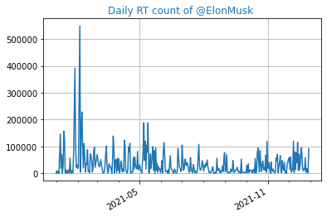
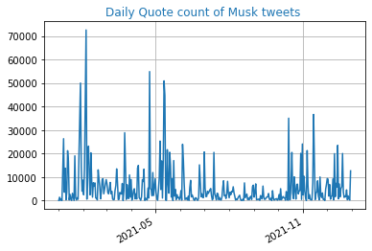
Exploration
Attempting to understand Musk’s popularity

Slide 7
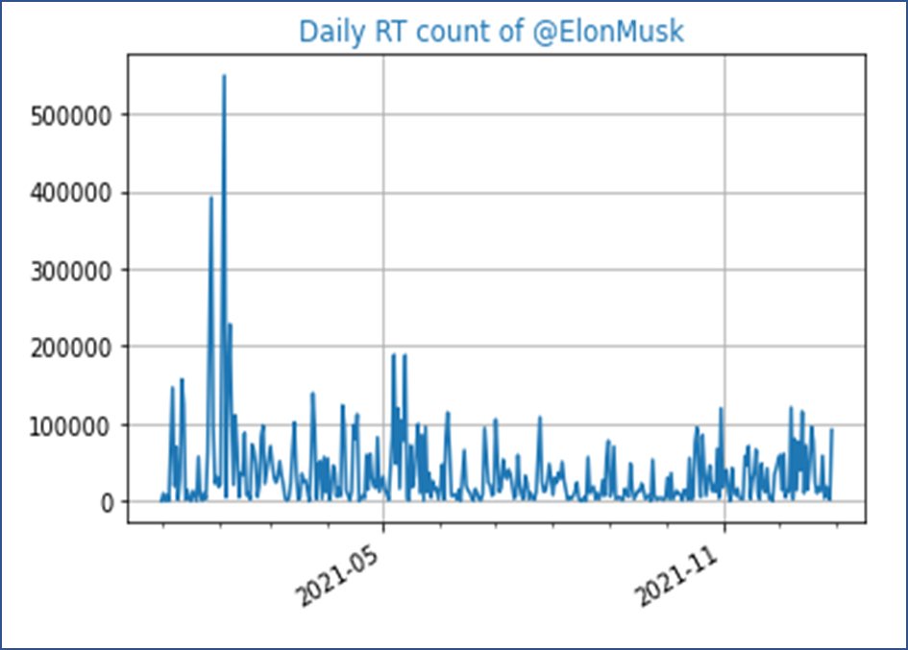
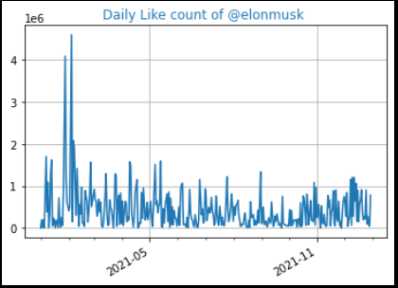
Exploration pt. 2
Attempting to understand Musk’s popularity

Slide 8
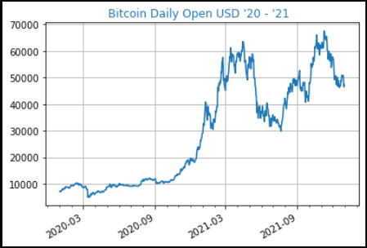
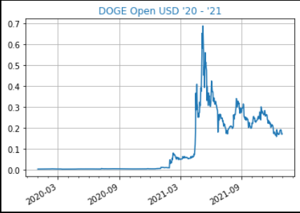
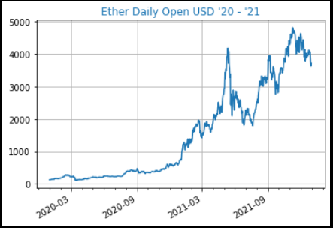
Market Data
Note from 2021-9 on

Slide 9
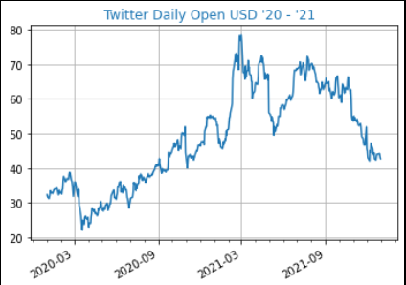

Addressing Influence
Making a point about Market data

Slide 10
Tokenization
Top 25 Tokens ‘20 – ‘21
Musk’s Twitter Vocabulary
Attempting to understand Musk’s Vocabulary
Notice that he has some favorite terms(right is top tokens)
How often Musk used words related to Crypto(left were found as relevant)
Attempting to join a non-duplicated instance of tweets containing
Doge, Bitcoin, etc.
Crypto Tokens ‘20 – ‘21

Slide 11
Conclusion
Information overload –
Crypto Acronyms –
Joining multiple tweets per day with Market Data
Musk’s domain
Next Steps

Slide 12
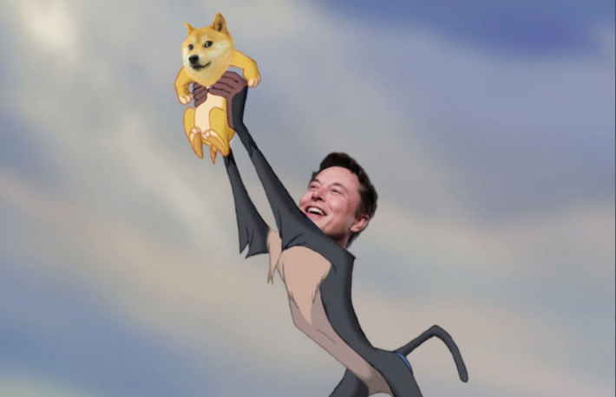
Thank you
Questions?

Slide 13
Images Used:
Title Slide:
https://twitter.com/elonmusk/status/1530380264966434823?s=20&t=6TLfJhsVUBWwknDC3mKvAA
Transition title Slide:
https://theglobalcoverage.com/2021/05/17/elon-musk-launching-satellite-named-doge-1-to-the-moon/
Questions Slide:
https://www.coindesk.com/markets/2021/02/04/elon-musk-is-back-tweeting-about-dogecoin-as-price-rises-50/

